Slide 1
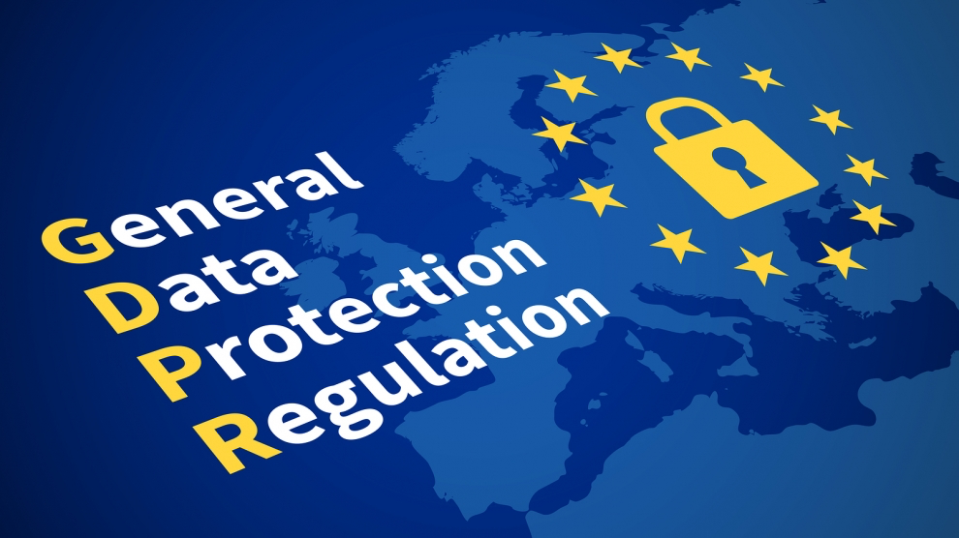
Futurewei GDPR Consulting Service Introduction
Futurewei Boston Solution Group

Slide 2





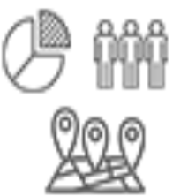
What is GDPR?
Data Governance
GDPR (General Data Protection Regulation) is a set of necessary compliance, that European Union regulates how companies (Data Controller and Data Processor) interact with, collect, and store personal information about consumers (Data Subject).
GDPR lays down the lawful consent for obtaining customer information, customer rights over the information they share, and legal basis for processing the information by companies.
Data Controller
Data Processor
A Controller determines the purposes and means of processing personal data
A Processor is responsible for processing data on behalf of a controller

Slide 3
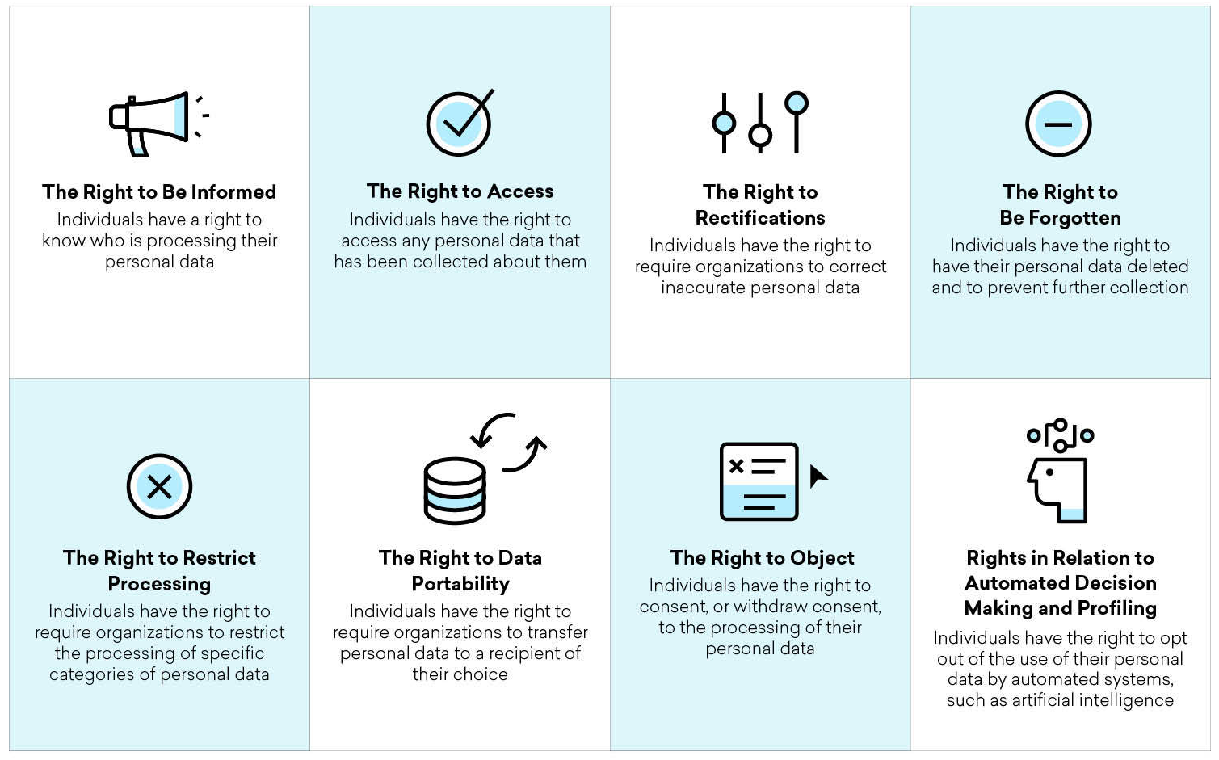
Rights of Data Subject, Service and Principles
Data subject
Controller and Processor
Transparency and modalities (Art. 12)
Information to be provided (Art. 13 & 14)
provide
Data protection (Art. 25 & 35)
Security of processing (Art. 32)
Records of processing (Art. 30)
Notification of breach (Art. 33 & 34)
Principles of processing personal data (Art. 5)
Lawfulness, fairness and transparency
Purpose limitation
Data minimization
Accuracy
Storage limitation
Integrity and Confidentiality
Notes:
Transparency and modalities (Art. 12): Transparent information, communication and modalities for the exercise of the rights of the data subject
Information and access to personal data
Information to be provided where personal data are collected (Art. 13 & 14);
Right of access by the data subject (Art. 15).
Rectification and erasure
Right to rectification (Art. 16);
Right to erasure / Right to be forgotten (Art. 17);
Right to restriction of processing (Art. 18);
Notification obligation regarding rectification or erasure of personal data or restriction of processing (Art. 19);
Right to data portability (Art. 20).
Right to object and automated individual decision-making
Right to object (Art. 21);
Automated individual decision-making, including profiling (Art. 22)
Restrictions (Art. 23): Union or Member State law to which the data controller or processor is subject may restrict by way of a legislative measure the scope of the obligations and rights.

Slide 4
Scope of the Law
Apply to
NOT apply to
Material Scope (Art. 2)
Territorial Scope (Art. 3)
The processing of personal data wholly or partly by automated means, and to the processing (filing system) not by automated means.
A controller or a processor that is established in the Union, regardless of whether the processing takes place in the Union or not.
NOT applies to an activity: a) which falls outside the scope of Union law;
b) by the Member States which fall within the scope of Chapter 2 of Title V of the TEU; c) by a natural person for a personal/household activity; d) by competent authorities for criminal related activities.
A controller or a processor that is not established in the Union, but its activities are related to:
a) the offering of goods or services; or
b) the monitoring of their behavior as far as their behavior takes place within the Union.
A controller not established in the Union, but in a place where Member State law applies.
Notes:
Material Scope (Art. 2)
Applies to the processing of personal data wholly or partly by automated means, and to the processing other than by automated means which form part of a filing system;
Not applies to the processing of personal data:
of an activity which falls outside the scope of Union law;
by the Member States which fall within the scope of Chapter 2 of Title V of the TEU;
by a natural person for a purely personal or household activity;
by competent authorities for the purposes of criminal related activities.
Territorial scope (Art. 3)
Applies to the processing by a controller or a processor that is established in the Union, regardless of whether the processing takes place in the Union or not;
Applies to the processing of personal data of data subjects (in the Union) by a controller or processor not established in the Union, where the activities are related to:
the offering of goods or services; or
the monitoring of their behaviour as far as their behaviour takes place within the Union.
Applies to the processing by a controller not established in the Union, but in a place where Member State law applies by virtue of public international law

Slide 5
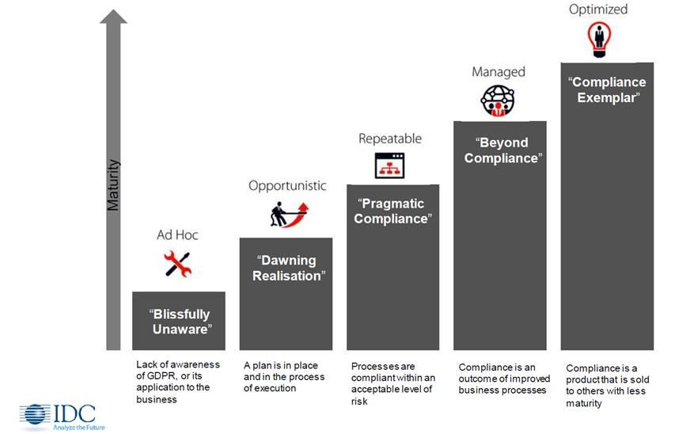
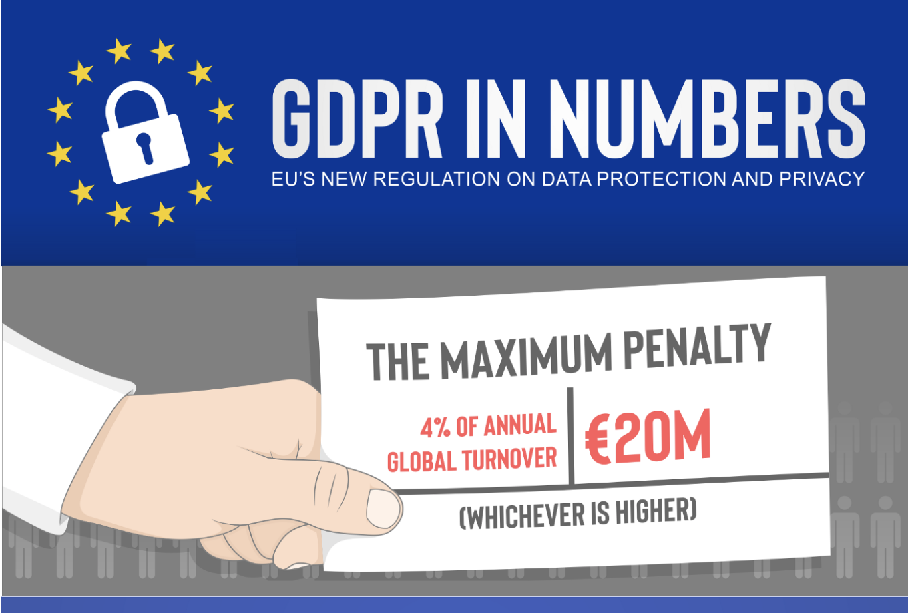
Journey of GDPR, Compliance Level and Consequences for Companies
Regulation Adoption
Effective & Enforceable
Implementing & Enforcement
Monitoring & Feedback
Compliance
Adopted on 14 April 2016
Influence on other countries
US - CCPA on 28 June 2018
Potential Lawsuits, Auditing and Fines
Proposed on 25 Jan 2016
Enforceable on 25 May 2018
€200 billion investment needed for European companies
Continuously monitoring level of compliance

Slide 6

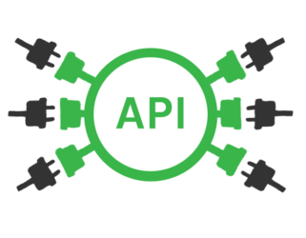






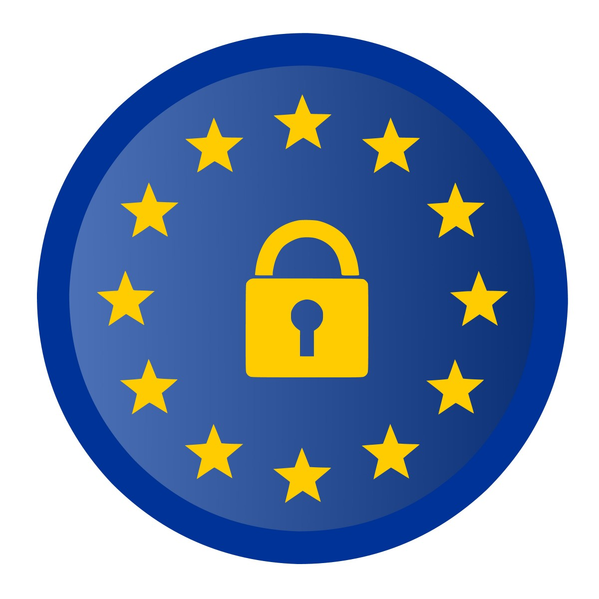






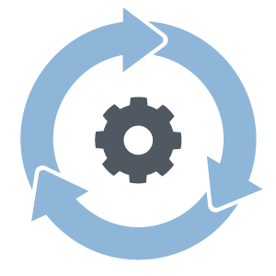

Functionalities and roles of IT systems in GDPR
Data controller
Data processor
<<GDPR-compliant
Backup and archive provider>>
GDPR
Entrust
Data processor
Data subject
Tagging
GDPR services
Orchestration
Gives consent for the data usage.
Data catalog
GDPR
Business goals
GDPR services
Data Ingestion
Entrust &
employ
Data catalog
Entrust & employ
<< GDPR compliant data consuming and processing provider>>
GDPR services
<<GDPR-compliant
Storage provider>>
GDPR services
GDPR
Data catalog
GDPR backup gateway
GDPR storage gateway
Backup and archive
Entrust & employ
Data processor
Storage
Storage
Processing
Snapshot
DR
Snapshot
Data Storage
Data Storage

Slide 7

Storage vendor GDPR capability/competitive model (levels)
Auditing is AI-assisted to detect any GDPR violation within minutes. Minimize any potential impact.
Proactive/intelligent GDPR compliant
Intrusion detection is AI-assisted and policies can be updated automatically.
Level 4. AI-assisted GDPR compliance
AI-assisted GDPR enforcement.
GDPR policies can be reviewed and modified via a policy-based interface.
GDPR enforcement reports can be generated instantly for review and compare to GDPR policies.
One or two (partially fit)
Level 3. Policy-based GDPR compliance
GDPR compliance is policy-based and provable.
Small granularity (file, record) for data protection and encryption
Need a short time (seconds) to get a report of data location, auditing logs to show GDPR compliance.
Need a short time (minutes or hours) to make sure the “right to be forgotten” requests are satisfied.
Some storage vendors
Fully automated. GDPR compliance is provable.
Level 2.End-to-end provable GDPR compliance
Need a long time (hours or even days) to make sure the “right to be forgotten” requests are satisfied.
Most current storage vendors
Some GDPR compliance steps are based on manual processing.
Large granularity (LUN, volume) for data protection and encryption
Need a long time (hours) to get a report of data location, auditing logs to show GDPR compliance.
Level 1. Basic GDPR compliance
Defensive/manual GDPR compliant
Functional Completion

Slide 8
Futurewei’s GDPR Consulting Service Engagement Phases and Processes
Plans, Roadmaps and Technical measures
Futurewei
works with customer to conduct storage specific gap analysis
Recommend appropriate software to facilitate gap analysis.
Auditing, Monitoring and Compliance Report generated Policies Enforced
Provides consulting services to facilitate customer IT team to continuously monitor, audit and assess GDPR compliance level of storage infrastructure
Provides recommendations regarding new GDPR law and policy changes.
Assessment
Governance & Design
Transform & Deploy
Operate & Monitor
Detailed Implementation Plan and Policies
Futurewei
Works with customer to recommend appropriate action plan to close GDPR gaps
Works with customer internal IT to devise a storage GDPR compliance architecture & design , makes conscious decisions on storage products and related software purchases.
Processes, Tools and Policies deployed
Works with customer IT team to deploy and transform customer IT storage infrastructure into GDPR compliant data platform.
Deploys monitoring, security audit and assessment tools by leveraging storage vendor GDPR capabilities.
Notes:
Assessment - Conduct GDPR risk and privacy assessments across governance, people, processes, data, security
Develop GDPR Readiness Roadmap
Identify and map personal data
IT governance, data protection and security: checking that best practices are in place throughout the business for management of personal data. This includes policies and procedures, accountability, reporting mechanisms and performance assessments.
Risk management: ensuring that companies conduct regular risk assessments and that the necessary regime is in place for effective risk management. Making sure assessment of risk to data subjects in processing their data takes place.
Data protection officer readiness: deciding whether a DPO is necessary, helping appoint a DPO.
Privacy By design and default: making sure staff know their roles and responsibilities and ensuring the company can readily prove compliance. Using GDPR for competitive advantage and putting infrastructure in place that allows that.
Scope of compliance: evaluation of the breadth of a company’s necessary compliance. This takes into account all data processing, data mapping and identifies cross-border processing, which often carries extra risk.
Personal information management system (PIMS): examining a company’s system of documentation and ensuring it’s in scale with the size and complexity of the business. Adjusting or streamlining it to align with GDPR needs.
Information security management system (ISMS): making sure the company’s ISMS fulfills its role of minimizing risk while efficiently managing sensitive data.
Rights of data subjects: facilitating the various rights of natural persons (e.g. access rights, data erasure, portability, rectification, right to know name of DPO). Underlining the burden of proof that lies with data controllers in demonstrating grounds to override these rights.
Data breach readiness and response: installing policies and procedures that enable fast reaction to data breaches and prompt reporting of them.
Governance & Design - Design governance, training, communication, and process standards
Design privacy, data management and security management standards
Develop and embed procedures, processes and tools • Deliver GDPR training
Develop and embed standards and policies using Privacy by Design, Security by Design
Detailed Data Discovery
Transform & Deploy - Execute all relevant business processes
Monitor security and privacy using TOMs
Manage consent and data subject access rights
Operate & Monitor - Monitor, assess, audit, report and evaluate adherence to GDPR standards

Slide 9
SAMPLE: GDPR Solution in a Banking System Data Center Environment
Reporting and Impact Analysis
Reporting and Impact Analysis
Enterprise GDPR
Framework
Core Bank Business Transaction System
Enterprise GDPR
Lifecycle
Production Data
Core Database
Core Unstructured Data
Secondary Data
DR Data
Backup Archiving
Data
Governance
Online Transaction System
Batch Transaction System
Customer CIF
Accounting System
Data Warehouse
Big Data Platform
Video Surveillance
Test & Dev
VDI
Assessment
Storage GDPR Framework
Governance & Design
Compliance
Management
Metadata & data governance
Monitoring, Auditing & Reporting
Access control
Encryption
Metadata Indexing
For query
Auditing Report
Event Notification
Geo-aware replication
WORM
RBAC
Customer Key Encryption
Data Usage Report
Virus Checker
FileAutoPolicy
Timely deletion
File
Data states (readiness)
Auditing
KMIP
Data in Flight Encryption
Risk
Assessment
Log Collection & Filtering
Delete & Un-map
Allow Write/Update
Transform & Deploy
Data geo location
Anomaly Detection
MFA
Check Permission
SED
Processing Report
Secure Erasure
Lineage
Pseudonymization
Operate & Monitor
Breach
Response
Data Integrity
HA
Storage Platforms
Block
File
Object
HDFS
Public Cloud Data Services
OTC
Orange Cloud
Data Replication
Snapshot
Archiving & Backup
Edge Storage
Primary Storage
Distributed Storage
AWS
Azure
Google

